Slide 1
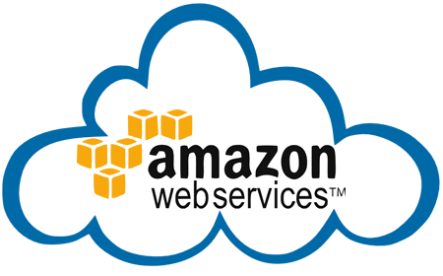
DAY 1
Amazon Web Services
Chapter 1 : Cloud Computing

Slide 2
What is Cloud Computing?
Cloud computing is an internet-based computing service in which large groups of remote servers are networked to allow centralized data storage, and online access to computer services or resources.
Using cloud computing, organizations can use shared computing and storage resources rather than building, operating, and improving infrastructure on their own.
Cloud computing is a model that enables the following features.
1.Users can provision and release resources on-demand.
2.Resources can be scaled up or down automatically, depending on the load.
3.Resources are accessible over a network with proper security.
4.Cloud service providers can enable a pay-as-you-go model, where customers are charged based on the type of resources and per usage.

Slide 3
Several Historical Trends
Shared Utility Computing
1960s – MULTICS – Concept of a Shared Computing Utility
1970s – IBM Mainframes – rent by the CPU-hour. (Fast/slow switch.)
Data Center Co-location
1990s-2000s – Rent machines for months/years, keep them close to the network access point and pay a flat rate. Avoid running your own building with utilities!
Pay as You Go
Early 2000s - Submit jobs to a remote service provider where they run on the raw hardware. Sun Cloud ($1/CPU-hour, Solaris +SGE) IBM Deep Capacity Computing on Demand (50 cents/hour)
Virtualization
1960s – OS-VM, VM-360 – Used to split mainframes into logical partitions.
1998 – VMWare – First practical implementation on X86, but at significant performance hit.
2003 – Xen paravirtualization provides much perf, but kernel must assist.
Late 2000s – Intel and AMD add hardware support for virtualization.

Slide 4
Types of Cloud
Cloud computing is usually described in one of two ways. Either based on the cloud location, or on the service that the cloud is offering.
Based on a cloud location, we can classify cloud as:
public,
private,
hybrid
community cloud

Slide 5
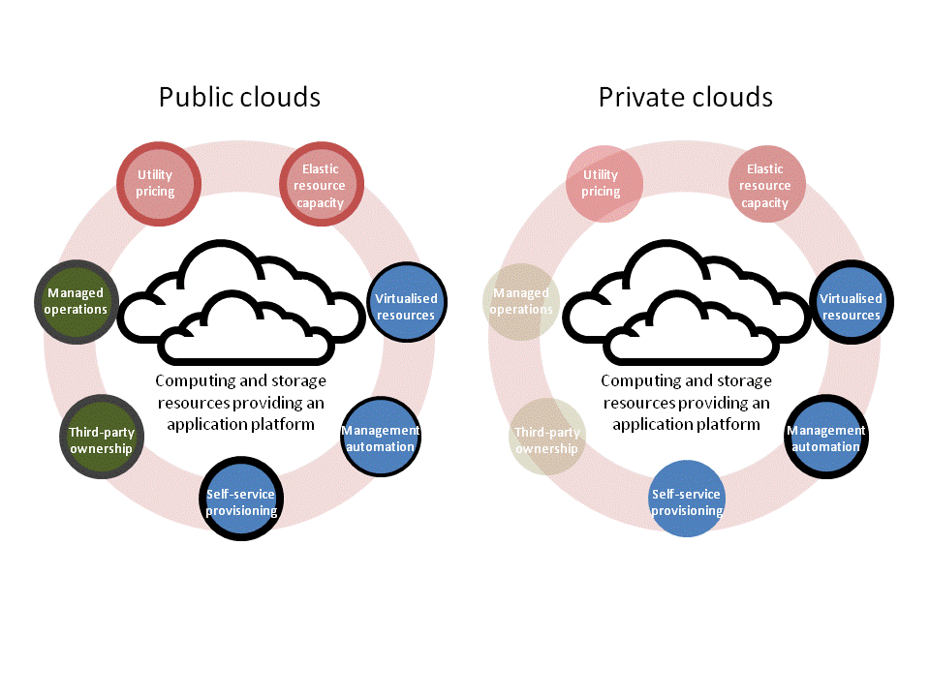

Slide 6
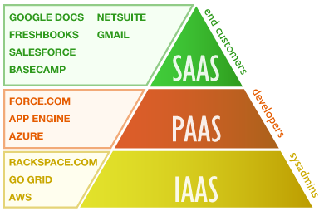
Based on a service that the cloud is offering, we are speaking of either:
IaaS (Infrastructure-as-a-Service)
PaaS (Platform-as-a-Service)
SaaS (Software-as-a-Service)
or, Storage, Database, Information, Process, Application, Integration, Security, Management, Testing-as-a-service

Slide 7
Advantages and Disadvantages of Cloud
Advantages
Cost Saving
Reliability
Easy Access to information
Strategic Edge
Unlimited Storage
Backup & recovery
Disadvantages
Downtime
Security Issues
Not easy to Swtich service providers
Limited Control

Slide 8
Six Advantages and Benefits of Cloud Computing
Trade capital expense for variable expense
Instead of having to invest heavily in data centers and servers before you know how you’re going to use them, you can only pay when you consume computing resources, and only pay for how much you consume.
Benefit from massive economies of scale
By using cloud computing, you can achieve a lower variable cost than you can get on your own. Because usage from hundreds of thousands of customers are aggregated in the cloud, providers such as Amazon Web Services can achieve higher economies of scale which translates into lower pay as you go prices.
Stop guessing capacity
Eliminate guessing on your infrastructure capacity needs. When you make a capacity decision prior to deploying an application, you often either end up sitting on expensive idle resources or dealing with limited capacity. With cloud computing, these problems go away. You can access as much or as little as you need, and scale up and down as required with only a few minutes notice.

Slide 9
Increase speed and agility
In a cloud computing environment, new IT resources are only ever a click away, which means you reduce the time it takes to make those resources available to your developers from weeks to just minutes. This results in a dramatic increase in agility for the organization, since the cost and time it takes to experiment and develop is significantly lower.
Stop spending money on running and maintaining data centers
Focus on projects that differentiate your business, not the infrastructure. Cloud computing lets you focus on your own customers, rather than on the heavy lifting of racking, stacking and powering servers.
Go global in minutes
Easily deploy your application in multiple regions around the world with just a few clicks. This means you can provide a lower latency and better experience for your customers simply and at minimal cost.

Slide 10
Future of Cloud Computing
A cloud allows users to access application, information, and data of all sorts on an online level rather than by use of actual hardware or devices. A company offering reliable cloud technology allows for computing to be done in a much more shared way, as a cloud provides a service rather than a product. Users get and share their information in a way that can allow them to access and give access to the whole world or any groups of people within their cloud.
WHAT THE FUTURE OF CLOUD COMPUTING HOLDS
With cloud computing and the technology behind it there are many potential opportunities and capabilities. Cloud computing can open a whole new world of jobs, services, platforms, applications, and much more. There are thousands of possibilities beginning to form as the future of cloud computing starts to really take off.
For instance, vendors and service providers can get on board to develop new and different ways of selling their goods and services to the cloud users through the cloud technology.

Slide 11
Conclusion
The advantages of cloud computing is way too good, is quite cost effective and it is efficient. The drawbacks are incidental and almost negligible. The decision to opt for cloud based services is great with saving substantial costs with regards to installation and maintenance, reduced downtime, almost negligible manpower involved in monitoring the servers and no collateral investment with regards to the infrastructure required to house the servers in-house.

